Slide 1

UCONN OPIM 5272 FINAL PRESENTATION
Project on Automated Social Media Marketing
Team 3| Sahibpreet Singh | Manisha Kharche | KavisreeMariappan | Hassan Kani
1

Slide 2
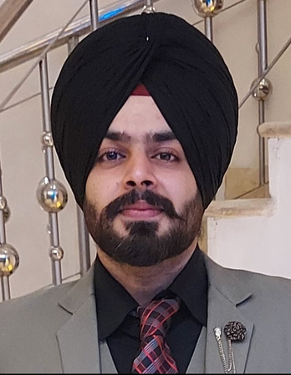



Team 3 | Project on Automated Social Media Marketing
MEET OUR TEAM MEMBERS
SAHIBPREET
SINGH
MANISHA KHARCHE
KAVISREE
MARIAPPAN
HASSAN
KANI
2

Slide 3

Introduction
Business Problem
Objective
Database ERD Diagram
Database Demonstration
Benefits
Conclusion
AGENDA
KEY DISCUSSION POINTS
Team 3 |Project on Automated Social Media Marketing
3

Slide 4

INTRODUCTION
In practice, digital marketing typically refers to marketing campaigns that appear on a computer, phone, tablet, or other devices. It can take many forms, including online video, display ads, search engine marketing, paid social ads, and social media posts.
Successful digital marketing campaigns depend on a team of digital marketing professionals and most importantly how the team is structured and working.
Marketing reporting is the process of measuring progress, showing value, and identifying actionable steps to improve marketing performance. The idea is to crunch the available numbers and analytics to help meet future marketing goals, whether that be earning more revenue, expanding service footholds, increasing the online audience which is shared with the client in the end.
Team 3 | Project on Automated Social Media Marketing
4

Slide 5

BUSINESS PROBLEM
In the field of Marketing, Social media managers are often seen "running" through a hassle by manually extracting the latest social data, plugging it into countless spreadsheets, and then ensuring that the right people have access to it, only to repeat the process all over again on a regular basis. This turns out to be an exhausting and unproductive process.
Social media reporting not only takes up your valuable time but hinders the growth of the company as it is often riddled with inaccurate data and human error. That's where social media report automation comes to the rescue.
Team 3 | Project on Automated Social Media Marketing
5

Slide 6

OBJECTIVES
Our objective with this project is to automate this entire process while collecting all the databases through the workflow and making it more efficient.
This project aims to help companies in this field grow rapidly with limited resources, reduce human errors, expedite the process with quicker and lesser handoffs while keeping track and managing everything with the help of automation.
After implementing the database management and business process modeling in the company’s workflow, the process will be entirely digital.
Target areas where business can be expanded.
Better tracking and analysis of the workflow where marketing campaigns performed poorly.
Quick responses to the current client and prospect future clients.
Team 3 | Project on Automated Social Media Marketing
6

Slide 7








WORKFLOW OF THE PROCESS
Team 3 | Project on Automated Social Media Marketing
Requests
Comes up with
Assigned
Client
Operational Manager
Campaign
Team
Creates
Shares
Evaluates
Deliverable
Reports
7

Slide 8
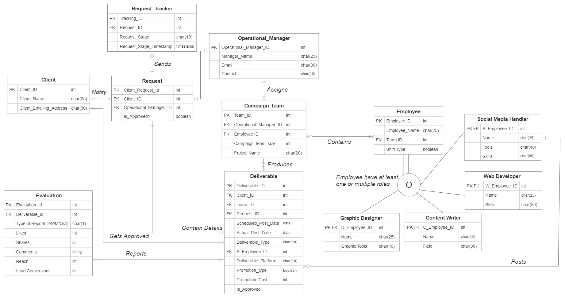

ENTITY RELATIONSHIP DIAGRAM
Team 3 | Project on Automated Social Media Marketing
8
Notes:
ABV

Slide 9
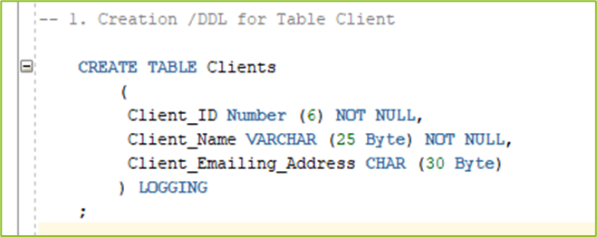
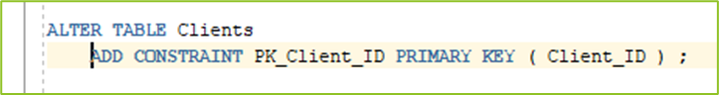

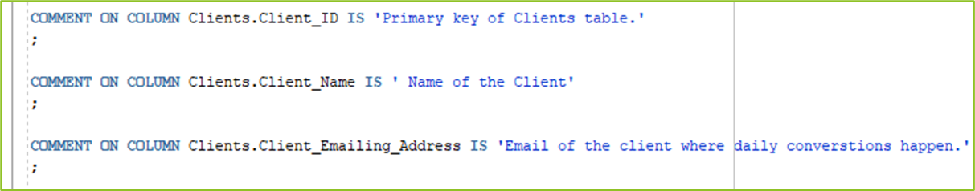
DATABASE DEMONSTRATION
Added Primary & Foreign Keys
Created Table
Added Comments
Team 3 | Project on Automated Social Media Marketing
9

Slide 10
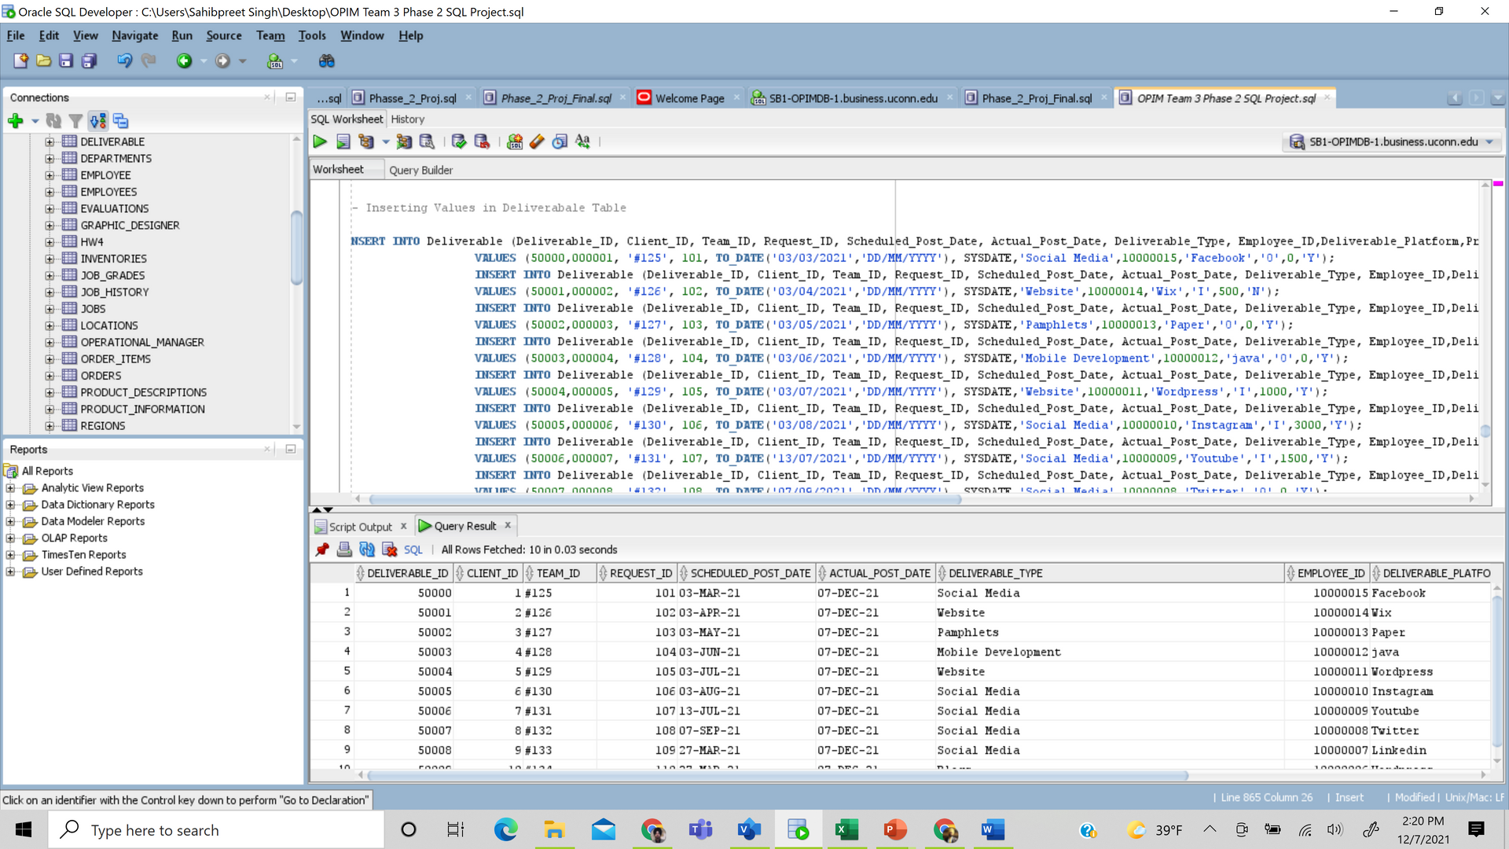
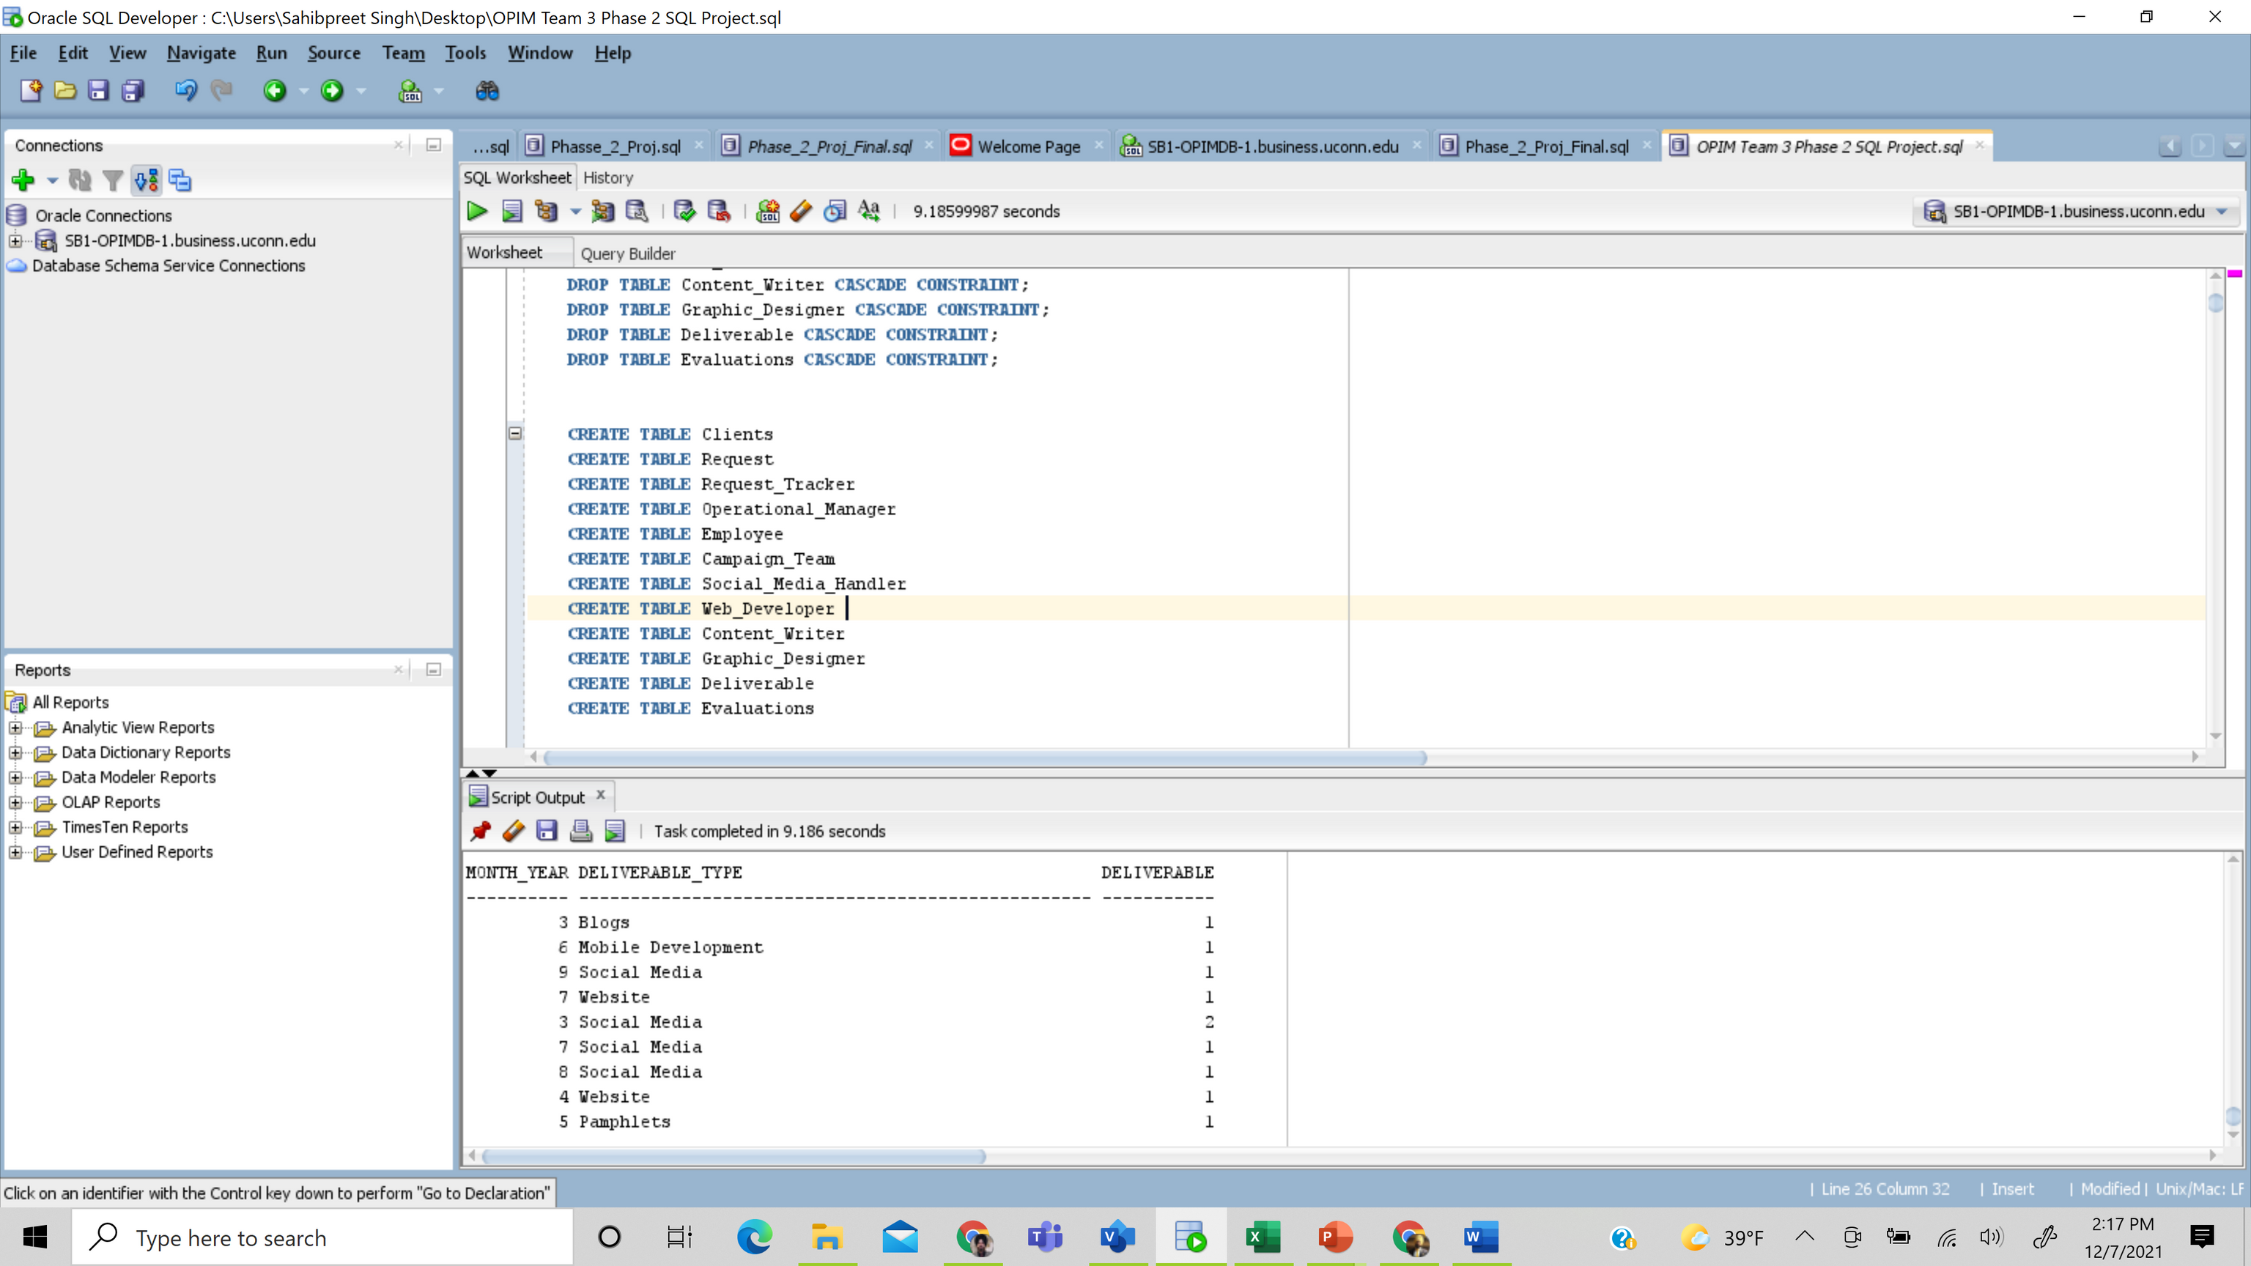
DATABASE DEMONSTRATION
Created 12 tables for this project
10 - 15 records were added each table
Team 3 | Project on Automated Social Media Marketing
10

Slide 11
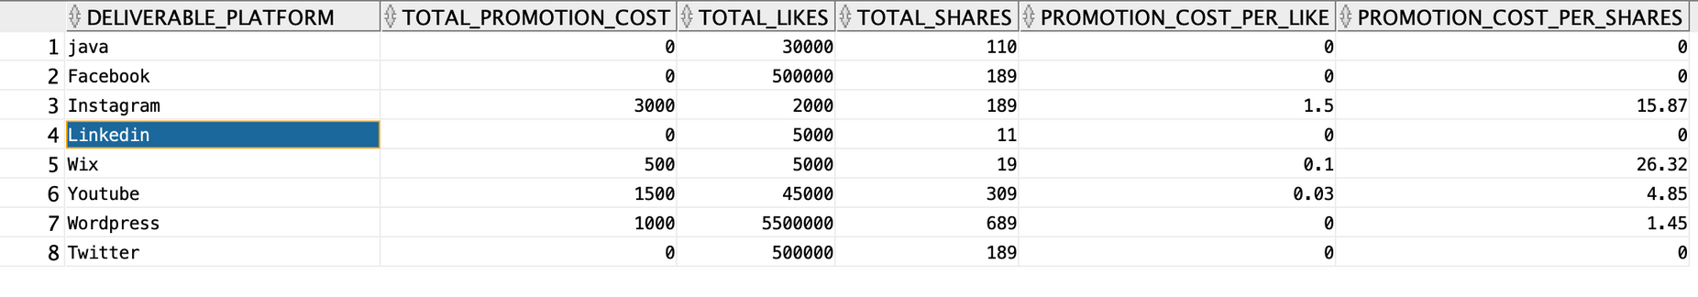
SQL REPORT 1
Team 3 | Project on Automated Social Media Marketing
Create a report to find the total promotion cost, likes and shares for every platform. Also find the cost of promotion per like and cost of promotion per share.
Purpose of the report : This report is used to show the cost per share and cost per like received.
Benefits - This will be useful to monitor and highlight the best performing platform for the clients.
Based on the information in this report, clients can make decision about the desirable platform based on reach / cost / r eturn on investment.
11

Slide 12
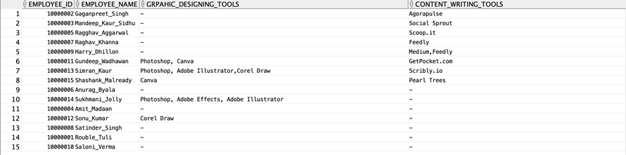
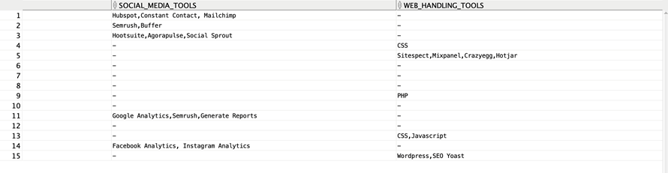
SQL REPORT 2
Team 3 | Project on Automated Social Media Marketing
Create a report showing all employees a list of all the tools they have hands-on experience with.
Purpose of the report: This report helps the manager to easily identify the right employees for the project based on the tools required.
benefit: Managers can make use of the available resources more efficiently which in turn saves time and thereby increases efficiency.
12

Slide 13
BENEFITS
Reduce efforts & maintain consistency
Save time for more value-added tasks
Cross network insights
Higher Data Accuracy
Provide Social Listening
Multi-Faceted use with easy sharing
Increased collaboration
On-time reports Delivery
Pick the right report that meets the needs
Tailored targeting efforts
Improved customer service and better engagement
40
30
20
10
0
Deliverable 1
Deliverable 2
Deliverable 3
Deliverable 4
Team 3 | Project on Automated Social Media Marketing
13

Slide 14

CONCLUSION
As you can see, our reports were useful because they can be used to quickly pull up important information automatically. This information could even be pulled and used by a different department to create visualizations and draw conclusions.
Higher-ups can make use of this information to make informed decisions about the current direction of the company, as well as the future.
With automated social media reporting, we save time and create opportunities for other projects to be worked on. This increases the efficiency of the company and allows for more overall success.
By making automated reports, we can even not only produce results faster but with more accuracy.
Team 3 | Project on Automated Social Media Marketing
14

Slide 15

THANK YOU!
QUESTIONS?
Team 3 | Project on Automated Social Media Marketing
15

